Slide 1



Some Key Regional Economic Trends since the Pandemic
ATU Galway: Guest Lecture
Dr Luke McGrath
Economist
Western Development Commission

Slide 2
Western Development Commission
State body – Department of Rural and Community Development (DRCD)
WDC Act 1998
‘….foster and promote the economic and social development of the Western Region’
7 county Western Region
(Clare, Donegal, Galway, Leitrim Mayo, Roscommon, Sligo)
Our work is built on 3 key pillars:
Regional promotion
Regional leadership
  Policy Analysis Team
Sustainable enterprise
Download WDC Strategy here

Slide 3
Disclaimer
The views expressed here are those of the author and do not necessarily represent or reflect the views of the WDC

Slide 4
Introduction
1) Note on Regional Data
2) Why Care about Regions?
3) Pre-Pandemic Regional Economic Structures
4) Regional Covid-Exposure Metrics
5) Labour Market Trends
6) Economic Activity Trends
7) Keys to Future Regional Growth
8) Summary

Slide 5
Note on “Regional” Data
Regional Data Constraints
  Lack of regional data in general!
  Considerable lag for regional key economic data.
  Trade off between availability and granularity
    NUTS vs County data
  WDC needs county data to construct “Western Region” data
  Often need to use “Northern and Western” “Border” & “West” as proxy or as supplement to county data.
Pandemic has clearly shown need for Timelier Economic Data
  WDC now provides a Timely Economic Indicators Series see here: https://westerndevelopment.ie/policy/publications/?q=timely%20economic
NUTS Regions
NUTS 2 | NUTS 3 | Counties
Northern & Western | Border | Cavan, Donegal, Leitrim, Monaghan, Sligo
 | West | Mayo, Roscommon, Galway
Southern | Mid-West | Clare, Tipperary, Limerick
 | South-East | Carlow, Kilkenny, Wexford, Waterford
 | South-West | Kerry, Cork
Eastern & Midland | Dublin | Dublin
 | Mid-East | Kildare, Meath, Wicklow, Louth
 | Midlands | Laois, Longford, Offaly, Westmeath

Slide 6
Source: WDC Analysis of CSO Data
National development is maximised when regions reach their full potential.
Regions outside of Dublin contribute a lot to the national economy!
  Regions outside of Dublin
    70% of Employment
    52% Gross Value Added.

Slide 7
Pre-Pandemic Economic Structures
Historical pattern of concentrated employment towards tourism, agriculture, and public services.
  Lower share of employment in Knowledge Intensive Services (KIS).
Enterprise structure reliant on very small firms (<10 employees).
  34% of “business economy” vs 16% in Dublin & 26% State.
High GVA shares in Public Services (24% vs 9% rest of State); Locally Traded Services (9.5% vs 8.5% rest of State) Construction (6% vs 2%) & Real Estate (11% vs 6%).
Regional divergence from last recession.
  Sluggish recovery in income, output and employment growth.
  Duality of public sector employment? Security yes, but growth prospects?
Source: WDC Analysis of CSO Data

Slide 8
COVID-Exposure: Output and Employment
Daly and Lawless (2020) list sectors “severely affected” by COVID-19.
Northern & Western and Midland have higher GVA exposure
  Driven by LTS, Construction and Real Estate
Western Region Employment exposure close to national average but the aggregate hides within region variation
  Donegal, Mayo comparatively high exposure + driven by high shares of accom. & food employment

Slide 9
Labour Market Trends: Live Register, PUP & Wage Subsidy
Regional Pandemic Trends
  Western Region counties generally higher, Live Register share, PUP share and Lower Wage Subsidy share than national average.
Regional & within-region labour market variation was highlighted as a key feature of the pandemic by Lydon & McGrath (2020) & McGrath (2021).
  Those studies suggest that the variation is related to, and in some cases, exacerbated historical regional structural Issues.
  Fear for regional variation in medium-longer term unemployment PUP and live register less certain to find re-employment than wage subsidy reciepients.
Source: WDC Analysis of CSO Data

Slide 10
Labour Market Trends: Covid-Adjusted Unemployment
CSO provide National Covid Adjusted Unemployment rates
  Assume all PUP recipients are “unemployed”
  CSO notes these are not “official” and represent upper bound.
I follow CSO approach to get regional estimates
  Avg. No of PUP recipients (weekly LR series) added to LFS “unemployed” then divided by Labour Force for each quarter from LFS
Border Region typically held highest Rates
  peak at 34.6% q2 2020.
Regional Covid Adjusted Unemployment Rate
 | 2020Q1 | Q2 | Q3 | Q4 | 2021Q1
State | 17.5 | 29.8 | 18.3 | 18.6 | 19.2
Border | 19.9 | 34.6 | 18.4 | 18.1 | 20.2
West | 16.6 | 30.7 | 16.7 | 16.1 | 18.6
Mid-West | 17.3 | 29.3 | 17.1 | 18.8 | 18.0
South-East | 19.7 | 31.8 | 17.9 | 18.0 | 19.4
South-West | 16.7 | 28.3 | 15.6 | 18.6 | 19.0
Dublin | 17.1 | 28.7 | 21.0 | 20.7 | 19.8
Mid-East | 17.1 | 29.5 | 17.9 | 17.4 | 19.0
Midlands | 17.1 | 29.3 | 17.0 | 16.3 | 16.5

Slide 11
Labour Market Trends: Job Loss Rates
Job loss rates provides an indication of re-employment possibilities.
  Methods from McGuiness and Kelly (2020).
No. “employed” from LFS divided by Avg No. in receipt of PUP.
Border Region held highest Rates
  peak at 30.9% q2 2020.
 | Regional Job Loss Rates
 |  | 2020Q1 | Q2 | Q3 | Q4 | 2021Q1
State |  | 13.5 | 25.8 | 11.8 | 13.6 | 20.6
Border |  | 15.2 | 30.9 | 12.1 | 14.3 | 21.4
West |  | 14.0 | 26.2 | 10.8 | 12.9 | 19.7
Mid-West |  | 13.0 | 25.1 | 11.0 | 12.4 | 19.2
South-East |  | 13.8 | 27.2 | 10.5 | 12.8 | 21.2
South-West |  | 13.2 | 25.0 | 10.3 | 12.9 | 20.6
Dublin |  | 13.1 | 24.6 | 13.6 | 15.2 | 21.4
Mid-East |  | 13.4 | 26.1 | 11.7 | 12.9 | 20.3
Midlands |  | 12.6 | 24.9 | 10.6 | 11.0 | 17.8

Slide 12
Economic Structures linked w/Covid impacts
Strong positive correlation b/t Covid-19 employment exposure and PUP % of LF.
  Pearson Coeff. = 0.7 (0.6 ex. Kerry and Donegal)
  Helps explain some within region variation E.g. Roscommon v Kerry
Potential for Regional (& within region) Medium Term Unemployment Variation
Longer term impacts relate to broader recovery - no plain sailing
  E.g. Roscommon % of public service employment may act as cushion but might constrain recovery phase?
Source: McGrath (2021)

Slide 13
“New Normal” Labour Market Trends: Live Register
As the Covid income supports wound down live register numbers began to rise – i.e. from August 2022.
  During January, 2023 live register numbers fell nationally, but remained stagnant across the Western Region.
  Higher regional shares of the labour force on the live register represent a continuation of a pre-pandemic trend related to regional economic & social structures.
Source: WDC Analysis of CSO Data

Slide 14
“New-Normal” Labour Market Trends: Unemployment
During the first half of 2022, Border and West regions unemployment rates were below national average
From Q3, Unemployment has risen above national average.
  At least in part linked with duality of Irish Economy (Foreign Multinationals v Domestic firms)
ILO Official Unemployment Rate
 | 2022Q1 | 2022Q2 | 2022Q3
State | 4.8 | 4.5 | 4.5
Border | 4.8 | 3.9 | 5.4
West | 3.5 | 3.8 | 4.5
Northern & Western | 4.1 | 3.9 | 4.9
Source: WDC Analysis of CSO Data

Slide 15
Economic Activity trends: Duality of Irish Economy
National accounts show pandemic trend of multinational sector overtaking domestic sector.
Western Region more dependant on domestic sector.
  Contraction in domestically owned firms during Q3 2022 - coincides with unemployment rates, in the Border region and West region above the national average.
Source: WDC Analysis of CSO Data

Slide 16
Economic Activity trends: Incomes & Output
Northern & Western HH incomes continued to grow (nominal) through 2020 & 2021
Northern & Western GVA fell during 2020 related to higher Covid exposure.
Inflation has had a sharp regional impact in 2022.
  Energy, Fuel & Food drivers of inflation
  Rural areas spend larger shares of income on these items
  SILC data shows a 1.4% fall in real HH incomes in Northern & Western Region.
Source: WDC Analysis of CSO Data

Slide 17
Economic Activity trends: Inflation!
Source: WDC Analysis of CSO Data

Slide 18
Economic Activity trends: Rural Price Inflation
Source: WDC Analysis of CSO Data

Slide 19
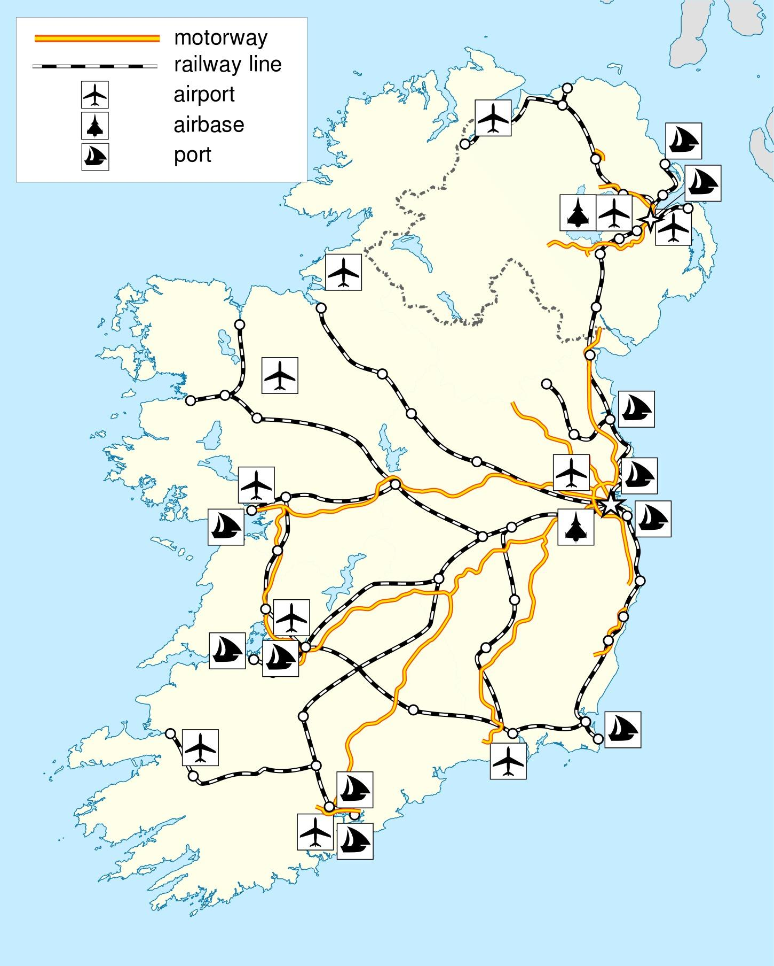
Keys to Future Regional Growth: Infrastructure Deficits (1)
Decades of underinvestment in Regional physical infrastructure
Road and Rail networks have focused on connectivity to Dublin.
  Deficits also for Ports and Airports
Need for delivery of NDP + priority for regional infrastructure.
Deficits in digital infrastructure too!

Slide 20
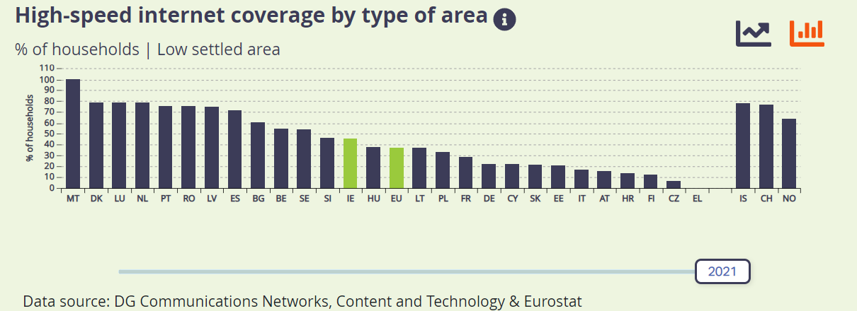
Keys to Future Regional Growth: Infrastructure Deficits (2)
Digital Infrastructure deficits too.
  Rural and regional entrepreneurs are constrained by internet speed and reliability.
  Need for delivery of National Broadband Plan.

Slide 21
Keys to Future Regional Growth: Infrastructure Deficits (3)
NTA Employment Accessibility Index
Why does this matter?
  Infrastructure supports employment.
  Infrastructure deficits mean employment opportunities are less accessible.
  Need to close regional infrastructure deficits to support regional development.
Source: NTA (2021)

Slide 22
Keys to Future Regional Growth: Human Capital/Education & Skills
Lower levels of educational attainment at regional level.
  Population with <lower secondary education
    Ireland 12%
    Northern & Western 15%
  Early Leavers from education & training
    Ireland 5%
    Northern & Western 6%
  % of Labour Force w/3rd level degree and/or employed in science & technology
    Ireland 58%
    Northern & Western 52%
Graduate retention issues.
  Share of graduates that worked within the region of their Higher Education Institute
    Dublin 69%
    Border 39%
    West 46%

Slide 23
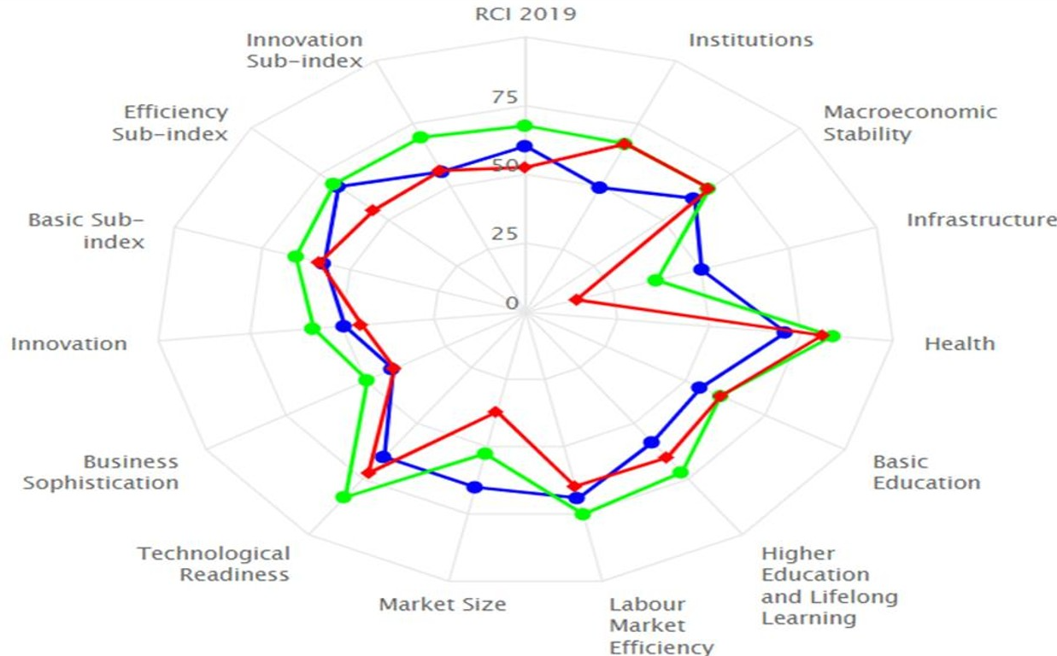
Keys to Future Regional Growth: Innovation (1)
Ireland is above EU avg. for many metrics.
  But Northern & Western Region considerably below Irish and EU Avg. across Innovation (& Infrastructure) + other metrics.
Note: Red = Northern & Western, Green = Ireland, Blue = EU avg.
Source: European Commission (2019)

Slide 24
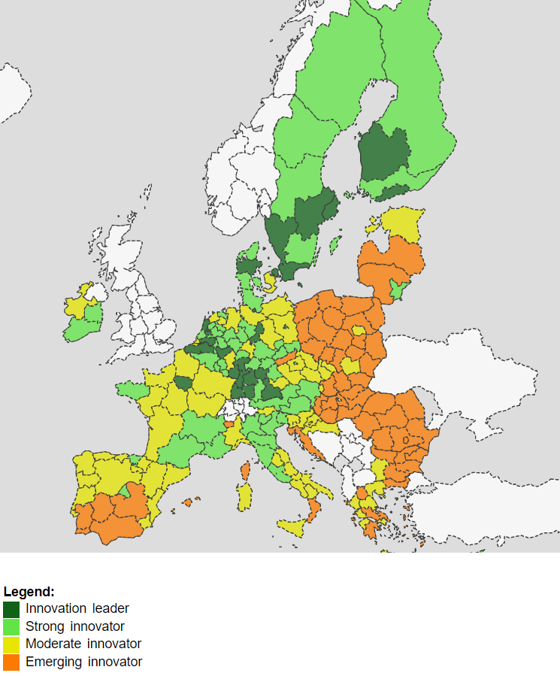
Keys to Future Regional Growth: Innovation (2)
Northern & Western Region only Irish Region classified as “moderate” innovator.
Need to support regional innovation
  WDC operates the Western Investment Fund.
  Need to boost Regional R&D.
Source: European Commission (2022)

Slide 25
Keys to Future Regional Growth: Enterprise & Employment
Western Region counties have a larger % of employment in the public sector (and lower % of employment in knowledge intensive services (KIS) sectors).
A simple econometric analysis of the 26 counties showed a moderate to strong negative correlation between employment growth and the share of employment in public services.
This implies that those counties with a larger share of public service employment had lower employment growth
Need to diversify employment – grow private sector - particularly KIS
Source: McGrath (2021)

Slide 26
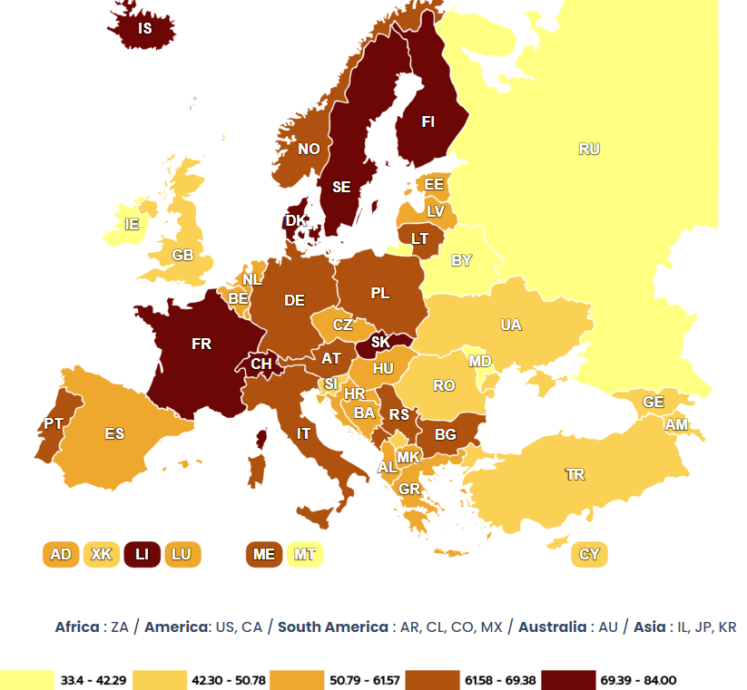
Keys to Future Regional Growth: Institutions (1)
Local government has little tax revenue raising powers or public expenditure power nor does it have autonomy over the functions it is responsible for.
  Lander et al (2021) note “In Cyprus, Ireland, Malta and Turkey, municipalities have very little influence when it comes to deciding on the services they are responsible for. They merely execute what has been decided on higher levels”.
  OECD (2013) notes “Local councils have very limited spending responsibilities. Ireland is one of the most centralised countries of the OECD”.
  OECD (2021) notes “Ireland’s civil service is highly centralised. Ireland has the second most centralised civil service in the OECD”.
Source: Lander et al. (2021)

Slide 27
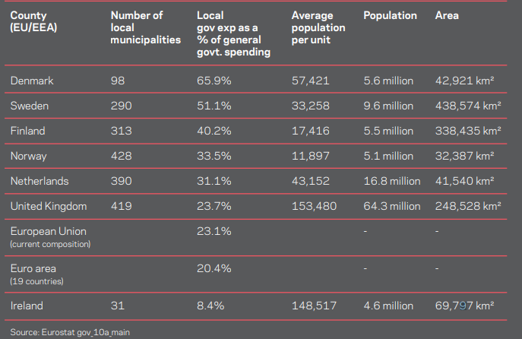
Keys to Future Regional Growth: Institutions (2)
Ireland is a considerable outlier in Europe.
  31 municipalities (i.e. county and city councils). With similar populations, Denmark, Norway & Finland have 98-428.
  Local government spending is <10% of total government spending in Ireland compared with 33.5-66% in Denmark, Norway & Finland.
Source: Forsa

Slide 28
Keys to Future Regional Growth: Housing (1)
Pandemic coincided with movement away from urban centres.
There had been strong regional growth in housing relative to population growth from 2006-22.
  Suggesting greater relative capacity to absorb sharp population growth from 2016-22.
As demand for regional housing has grown shortages are biting harder.
Source: WDC Analysis of CSO Data

Slide 29
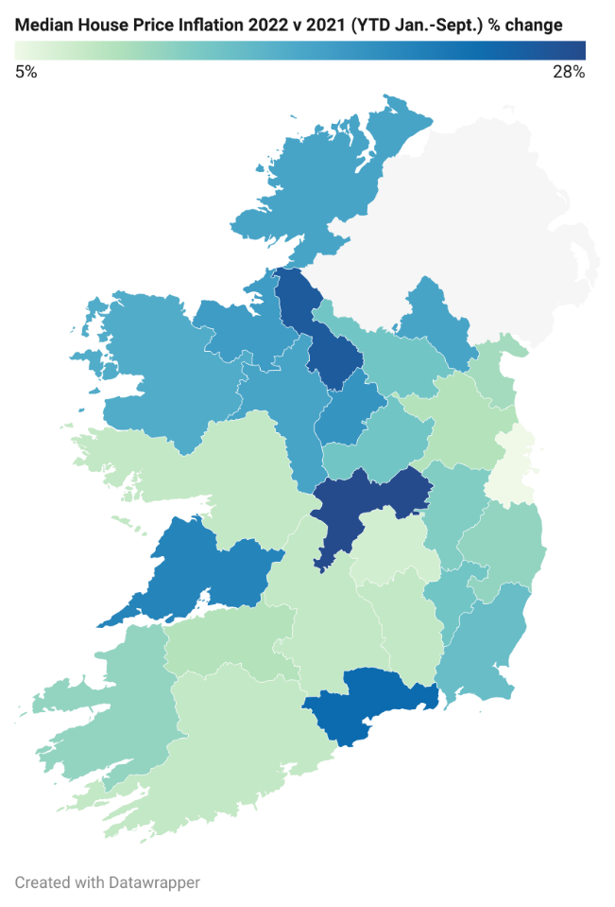
Keys to Future Regional Growth: Housing (2)
What happens to Prices when there is constrained supply and strong demand?
From December 2019- December 2022
  National Prices up 26%
  Dublin up 20%
  Border prices up 38%
  West prices up 37%.
Prices have increased more sharply outside cities and in cheaper markets.
Source: WDC Analysis of CSO Data

Slide 30
Policy Insights – Concluding Remarks
Regional dynamics of the COVID-19 shock influenced by pre-pandemic economic structures
  Reiterates the need for further diversification of the regional employment base – potential opportunities w/remote working.
Need to avoid repeat of sluggish recovery
  Future regional growth depends on the 3 I’s (Infrastructure, Institutions, Innovation), the 3 E’s (education, enterprise & employment) and housing.
  Sign up to the Policy Team’s Insights Mailing List here: https://mailchi.mp/b6a58ab3cf5a/insights-mailing-list

Slide 31
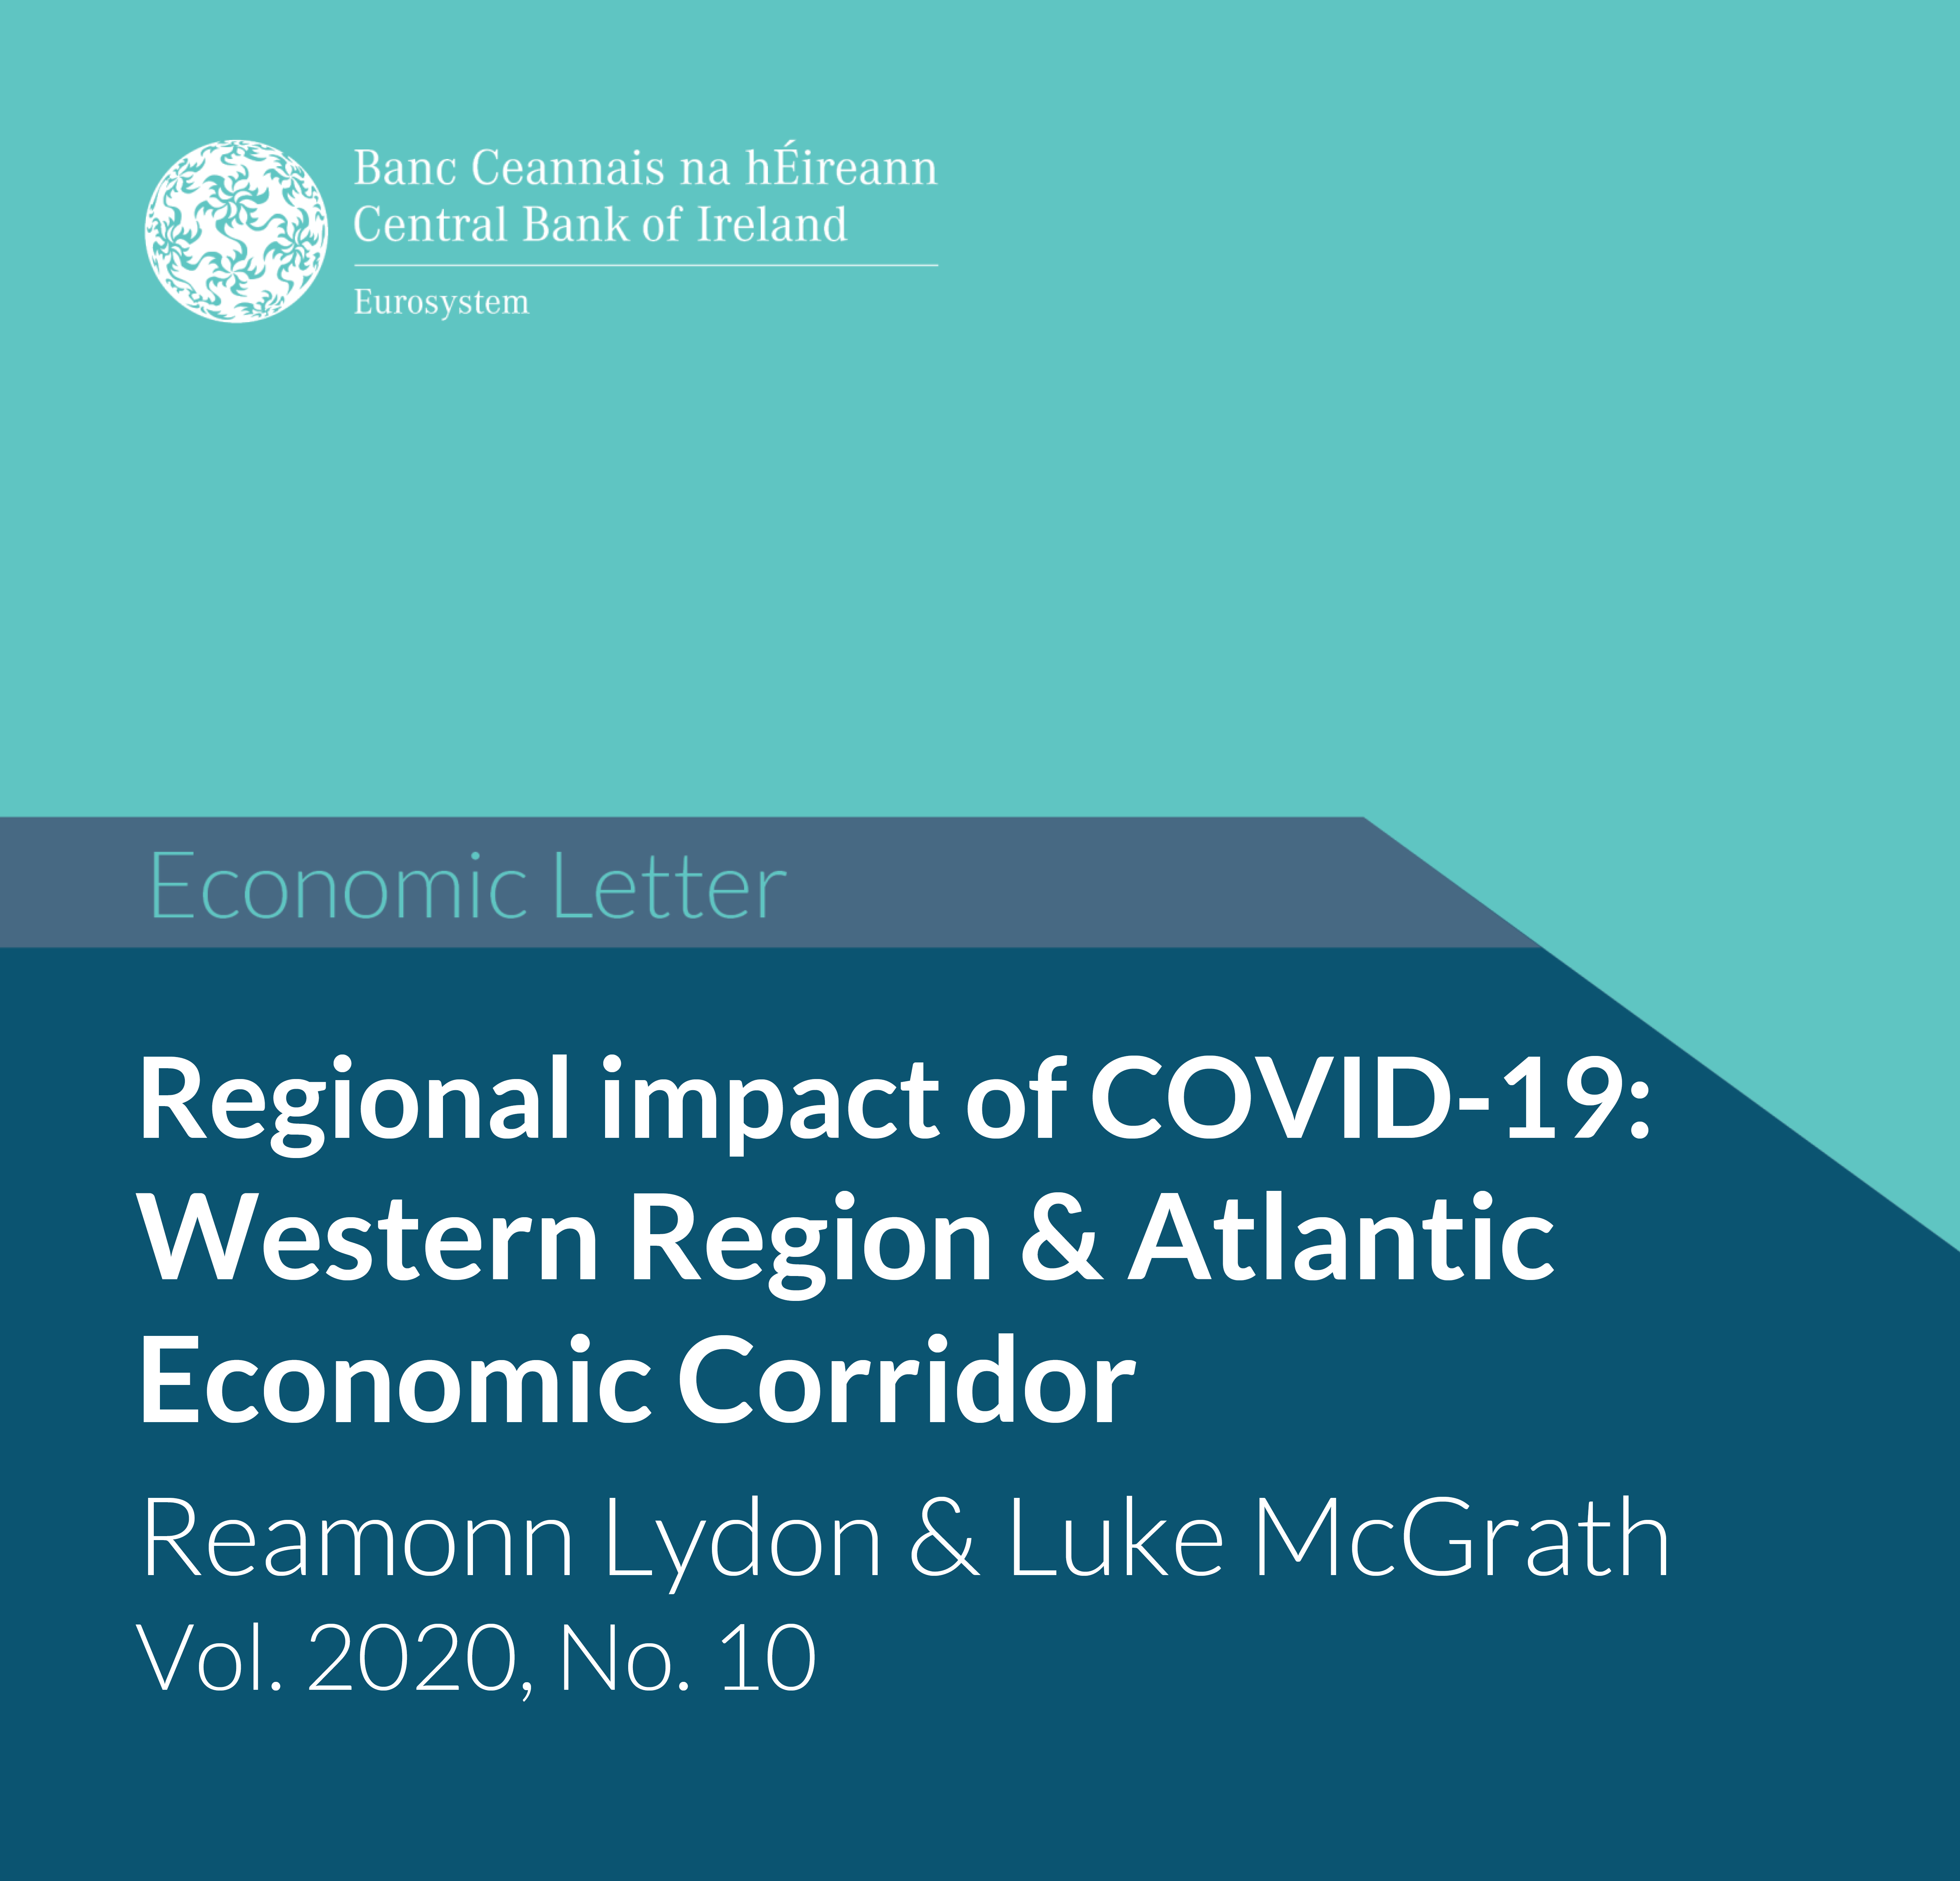
Questions/ Comments
Thank You
See our policy outputs here:
https://westerndevelopment.ie/policy/publications/
Follow our Insights Blog here:
https://westerndevelopment.ie/insights/
Sign up to the Policy Team’s Blog Mailing List here:
https://mailchi.mp/b6a58ab3cf5a/insights-mailing-list
View Here
View Here
Dr Luke McGrath
Economist
Western Development Commission

Slide 32
Additional Slide
Daly and Lawless COVID Sectors “severely affected” NACE 2 digit
  Mining, quarrying & extraction, construction & construction works, wholesale & retail trade & repair of vehicles, wholesale trade, retail trade, water transport services, air transport services, accommodation services, food & beverage services, publishing, film & broadcasting services, real estate activities, travel agency & tourism service activities, cultural, arts & gambling activities, recreation and sports activities, repair of consumer goods, other personal service activities.

