Slide 1
WDC Presentation: 9th Annual NERI Labour Market Conference. The Regional Economic Impact of COVID 19: The Western Region and Atlantic Economic Corridor
06/07/2021
Luke McGrath
Economist
Policy Analysis Team

Slide 2
Western Development Commission
State body – Department of Rural and Community Development (DRCD)
WDC Act 1998
‘….foster and promote the economic and social development of the Western Region’
7 county Western Region
(Clare, Donegal, Galway, Leitrim Mayo, Roscommon, Sligo)
Our work is built on 3 key pillars:
Regional promotion
Regional leadership
Sustainable enterprise
Download WDC Strategy here
Co-ordinating agency for Atlantic Economic Corridor (Western Region + Limerick and Kerry)

Slide 3
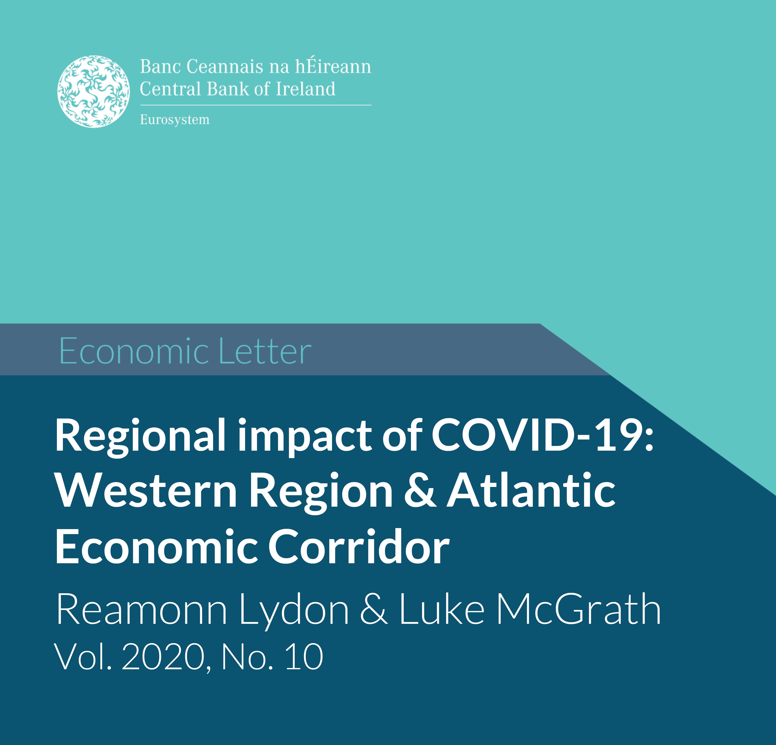
Introduction
1) Pre-pandemic Economic Structures
2) Covid-19 Exposure Metrics – Output & Employment
3) Regional Labour Market Impacts
4) Economic Structures Linked w/Impacts
5) Concluding Remarks
Report published in March 2021 – looking back at 2020.
Builds on Joint work with the Central Bank of Ireland (Lydon and McGrath, 2020)
Download the Report Here

Slide 4
Note on “Regional” Data
Regional Data Constraints
Considerable Lag for regional key economic data.
Trade off between availability and granularity
NUTS vs County data
WDC needs County data to construct “Western Region” data
Often need to use “Northern and Western” “Border” & “West” as proxy.
Pandemic has shown need for Timelier Economic Data
WDC now provides a Timely Economic Indicators Series see here: https://westerndevelopment.ie/policy/publications/?q=timely%20economic
NUTS Regions
Northern & Western | Border | Cavan, Donegal, Leitrim, Monaghan, Sligo
 | West | Mayo, Roscommon, Galway
Southern | Mid-West | Clare, Tipperary, Limerick
 | South-East | Carlow, Kilkenny, Wexford, Waterford
 | South-West | Kerry, Cork
Eastern & Midland | Dublin | Dublin
 | Mid-East | Kildare, Meath, Wicklow, Louth
 | Midlands | Laois, Longford, Offaly, Westmeath

Slide 5
Pre-Pandemic Economic Structures
Historical pattern of concentrated employment towards tourism, agriculture, and public services.
Low share of employment in Knowledge Intensive Services (KIS).
Enterprise structure reliant on very small firms (<10 employees).
34% of “business economy” vs 16% in Dublin & 26% State.
High GVA shares in Public Services (25% vs 10% rest of State); Locally Traded Services (16% vs 13%); Construction (7% vs 2.5%) & Real Estate (12% vs 5.5%).
Regional divergence from last recession.
Sluggish recovery in income, output and employment growth.
Duality of public sector employment? Security yes, but growth prospects?

Slide 6
COVID-Exposure: Output and Employment
Daly and Lawless (2020) list sectors “severely affected” by COVID-19.
N&W and Midland have higher GVA exposure
Driven by LTS, Construction and Real Estate
AEC/WR Employment exposure close to national average but the aggregate hides within region variation
Kerry, Donegal, Mayo comparatively high exposure + all 3 have high shares of accom. & food employment
% of Employment in COVID-19 “severely affected“ sectors
State | 30%
AEC | 30%
Kerry | 35%
Roscommon | 29%

Slide 7
Labour Market Impacts: COVID Payments
In general, AEC/WR aggregate for PUP % of LF above national average and EWSS below national average but considerable within-region variation.

Slide 8
Labour Market Impacts: COVID-Adjusted Unemployment Rates
CSO provide National Covid Adjusted Unemployment rates
Assume all PUP recipients are “unemployed”
CSO notes these are not “official” and represent upper bound.
I follow CSO approach to get regional estimates.
Avg. No of PUP recipients (weekly LR series) added to LFS “unemployed” then divided by Labour Force for each quarter from LFS
Border Region typically held highest Rates
peak at 34.6% q2 2020
Regional Covid Adjusted Unemployment Rate
 | 2020Q1 | Q2 | Q3 | Q4 | 2021Q1
State | 17.5 | 29.8 | 18.3 | 18.6 | 19.2
Border | 19.9 | 34.6 | 18.4 | 18.1 | 20.2
West | 16.6 | 30.7 | 16.7 | 16.1 | 18.6
Mid-West | 17.3 | 29.3 | 17.1 | 18.8 | 18.0
South-East | 19.7 | 31.8 | 17.9 | 18.0 | 19.4
South-West | 16.7 | 28.3 | 15.6 | 18.6 | 19.0
Dublin | 17.1 | 28.7 | 21.0 | 20.7 | 19.8
Mid-East | 17.1 | 29.5 | 17.9 | 17.4 | 19.0
Midlands | 17.1 | 29.3 | 17.0 | 16.3 | 16.5

Slide 9
Labour Market Impacts: Job Loss Rates
Job loss rates provides an indication of re-employment possibilities.
Methods from McGuiness and Kelly (2020)
No. “employed” from LFS divided by Avg No. in receipt of PUP.
Border Region typically held highest Rates
peak at 30.9% q2 2020
 | Regional Job Loss Rates
 |  | 2020Q1 | Q2 | Q3 | Q4 | 2021Q1
State |  | 13.5 | 25.8 | 11.8 | 13.6 | 20.6
Border |  | 15.2 | 30.9 | 12.1 | 14.3 | 21.4
West |  | 14.0 | 26.2 | 10.8 | 12.9 | 19.7
Mid-West |  | 13.0 | 25.1 | 11.0 | 12.4 | 19.2
South-East |  | 13.8 | 27.2 | 10.5 | 12.8 | 21.2
South-West |  | 13.2 | 25.0 | 10.3 | 12.9 | 20.6
Dublin |  | 13.1 | 24.6 | 13.6 | 15.2 | 21.4
Mid-East |  | 13.4 | 26.1 | 11.7 | 12.9 | 20.3
Midlands |  | 12.6 | 24.9 | 10.6 | 11.0 | 17.8

Slide 10
Economic Structures linked w/impacts & Recovery
Strong positive correlation b/t Covid-19 employment exposure and PUP % of LF.
Pearson Coeff. = 0.7 (0.6 ex. Kerry and Donegal)
Helps explain within region variation E.g. Roscommon v Kerry
Potential for Regional (& within region) Medium Term Unemployment Variation.
COVID- exposure explains initial impacts but may not determine LT term impacts given structural issues identified.
E.g. Roscommon % of public service employment may act as cushion but might constrain recovery phase?

Slide 11
Policy Insights – Concluding Remarks
Regional dynamics of the COVID-19 shock are influenced by pre-pandemic economic structures
Reiterates the need for further diversification of the regional employment base – potential opportunities w/ remote working.
Need to avoid repeat of sluggish recovery
Recent WDC Submissions on NDP Review to Renew + NIFTI.
Regional growth depends on Infrastructure & the 3 E’s (education, enterprise & employment).
Sign up to the Policy Team’s Insights Mailing List here: https://mailchi.mp/b6a58ab3cf5a/insights-mailing-list

Slide 12
Thank You See our policy outputs here: https://westerndevelopment.ie/policy/publications/ Follow our Insights Blog here: https://westerndevelopment.ie/insights/ Sign up to the Policy Team’s Blog Mailing List here: https://mailchi.mp/b6a58ab3cf5a/insights-mailing-list
20/10/2020
Luke McGrath
Economist
Policy Analysis Team

Slide 13
Additional Slide
Daly and Lawless COVID Sectors “severely affected” NACE 2 digit
Mining, quarrying & extraction, construction & construction works, wholesale & retail trade & repair of vehicles, wholesale trade, retail trade, water transport services, air transport services, accommodation services, food & beverage services, publishing, film & broadcasting services, real estate activities, travel agency & tourism service activities, cultural, arts & gambling activities, recreation and sports activities, repair of consumer goods, other personal service activities.

