Slide 1
Update on Next Generation Broadband 2016 Presentation to Roscommon Co Co 25.1.2016 Deirdre Frost, WDC

Slide 2
Outline of Presentation
1. Broadband – Where we have come from (1999-2011)
2. Next Generation Broadband – Where we are now (2012-2016)
3. Next Generation Broadband – Where we are going to…and when? (2016-2020)

Slide 3
The Western Development Commission
Statutory body, Dept. Environment, Community & Local Government – WDC Act 1998
7-county Western Region
‘… foster and promote the economic and social development of the Western Region’
4 work areas –
Policy Analysis
Regional Dev Initiatives, e.g. renewable, creative
Promotion – www.lookwest.ie
Western Investment Fund – risk capital to SMEs

Slide 4
Policy Analysis - Importance of Infrastructure
Recent WDC work on regional growth draws on OECD findings which show that:
Regions are the drivers of the national economy & All Regions have potential to contribute to economic growth.
Persistent regional disparities suggest unused growth potential
Infrastructure is a vital ingredient and weaker regions need similar quality infrastructure as is available in more successful regions to compete effectively

Slide 5
1. Broadband – Where we have come from
1999 - EU policy of deregulation of Telecommunications sector, sale of Telecom Eireann
2001 WDC ‘The State of the West’
2002 WDC ‘Update on
Telecommunications’

Slide 6
Where we have come from cont’d…
Government Policy response to deregulation:
County & Group Broadband Scheme CGBS – 2003-2007
MANs – 2004 onwards
National Broadband Scheme (NBS) – 2008-2014
Rural Broadband Scheme (RBS) – 2011 -2014

Slide 7
Broadband and Economic Growth
Broadband: No.1 priority infrastructure (National Competitiveness Council)
Transformative infrastructure & a basic utility; similar to electrification
Internet contributes 6% of GDP – 75% outside ICT sector
2.6 new jobs created for every job lost through efficiency
Jobs impact: Over 8,200 employed in ICT in WR
The 2nd largest sector in terms of assisted employment in WR (13%)

Slide 8
But..Ever growing Applications and Broadband speeds

Slide 9
2. Where we are now
From Basic to Next Generation/ Advanced
EU Digital Agenda Targets 2020 (published in 2010)
Government's National Broadband Plan 2012
WDC Connecting the West 2012

Slide 10
Government National Broadband Plan (NBP) – Aug 2012
NBP targets
Between 70 – 100 Mbps to more than 50% of pop. (by 2015)
40 Mbps to a further 20% (by 2016)
A minimum of 30 Mbps to ALL by 2016
Little detail on which speeds where but industry have outlined some of their plans for commercial investment - usually in higher density areas.

Slide 11
Likely pattern of Next Generation Deployment
National Broadband Plan – what it might look like
Three speed Ireland?
Cities: 100 Mbps+
Semi-urban (less than 10,000+): 40 Mbps
Rural areas – current NBS and RBS: 30 Mbps

Slide 12
Experience of users
Differential speeds - implications for different areas
Impact for investment – both FDI and domestic
Companies and residents in rural areas need similar speeds & bandwidth as urban areas
Domestic and e-Workers (tele-working, home business)
Knowledge intensive businesses – including agriculture!!
Online sales for all businesses, Video-conferencing
30Mbps – only a basic minimum

Slide 13
What are the Issues?
Role of state investment – addressing market failure
Technology choices and implications – long term infrastructure - Fibre V Wireless
VFM – state investment to date
Making the case for fibre Investment – long-term return 30-40 yrs+ Best ROI
Need to conclusively address deficits…for the long-term
Wireless still important

Slide 14
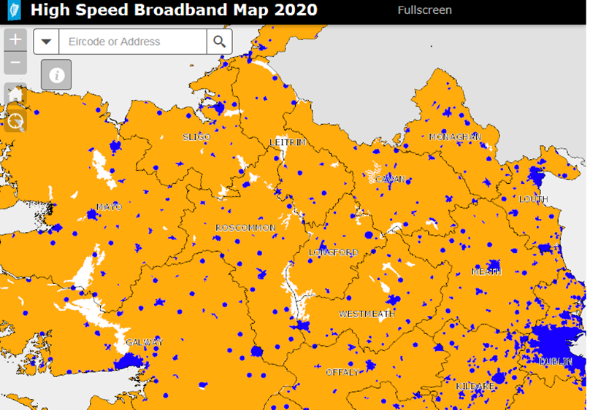
3. Where we are going – Next Steps
Government’s NBP
www.broadband.gov.ie
Blue & amber
Up to 38% unlikely
to be able to access
high speed broadband without NBP

Slide 15
Where we are going – Next Steps
Government’s NBP Updated December 2015
State co-investment
State-aid issues – sanction from EC
Procurement process
25 year contract
physical build of this network will take between 4 to 5 years to complete

Slide 16
Where we are going – Next Steps - Timescale
Formal tender process launched, (December 2015)
Government decision on preferred ownership model (Q1 2016) State or Private
Invitation to Participate in Dialogue (March 2016)
Final Tender and approval of Govt for overall strategy (Q3 2016)
Govt approval for contract finalisation and commencement of network build (end 2016)

Slide 17
WDC view
Need to conclusively address issue
Invest in fibre where possible
Close monitoring of industry rollout & state support
Open access to all state owned infrastructure & effective competition
Very strong regulation to support delivery to rural areas
Threats – funding, electoral cycle
Opportunity- Broadband no longer an impediment to living and working in rural Ireland

Slide 18
Thank You
Q & A
Deirdre Frost
Policy Analyst
Western Development Commission
Tel: 094 986 1441
E-mail: deirdrefrost@wdc.ie

