Slide 1
IBEC West Regional Executive Committee Census 2016 and Policy Implications – The West Region Deirdre Frost 10th May 2017

Slide 2
Western Development Commission (WDC)
7 county Western Region
State body – Department of Arts, Heritage, Regional, Rural & Gaeltacht Affairs
WDC Act 1998
‘….foster and promote the economic and social development of the Western Region’

Slide 3
WDC – What we do
Inform policy-making through analysis
of Region’s issues & needs
(e.g. infrastructure, labour market)
Promotion – www.lookwest.ie
Development of region’s resources
e.g.Creative sector, Tourism, Renewable energy
WDC Investment Fund – Risk capital to SMEs

Slide 4
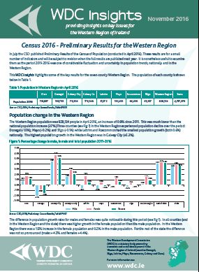
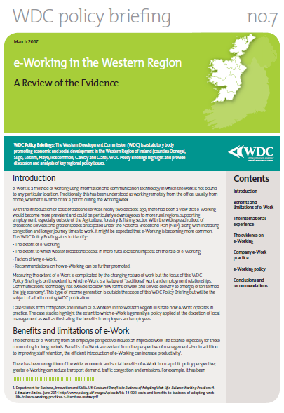
Update for IBEC West
Census 2016 – West Region findings
WDC work to support IBEC West Region
National Planning Framework – key asks
Capital Plan – Mid-term Review – key asks
Other relevant WDC work

Slide 5
Census 2016 – The West Region
Published results to-date
Preliminary Results July 2016
Summary Results – part 1 6 April 2016
Profile 1 – Housing in Ireland 20 April 2017
Forthcoming
Profile 2 – Population Distribution & Movements – 11 May
Profile 3 –Profile 11 throughout 2017

Slide 6
Census 2016 - Population & Population Change
 | Population 2016 | Actual Change (2011-2016) (No.) | Percentage Change (2011-2016) (%)
Galway City | 78,668 | 3,139 | 4.2
Galway County | 179,390 | 4,266 | 2.4
Mayo | 130,507 | -131 | -0.1
Roscommon | 64,544 | 479 | 0.7
West Region | 453,109 | 7,753 | 1.7
State | 4,761,865 | 173,613 | 3.8

Slide 7
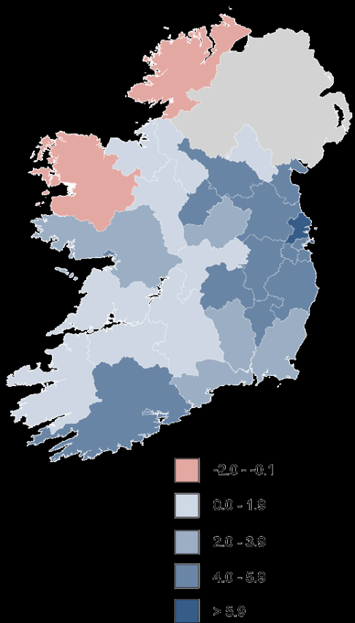
Census 2016 – Aspects of Population Change
Pop change
Galway city 4.2%
Co. Galway 2.4%
Co. Roscommon 0.7%
Mayo -0.1%
Age: State average = 37.4 years
Galway – 38 years
Mayo – 40.2 yrs
Roscommon – 39.7 yrs

Slide 8
Census 2016 – Age structure
Dependency: Age (0-14) + (65+)/ (15-64)
State – 52.7%
Galway city – 39% (lowest nationally)
Galway county – 59.2%
Mayo – 61.1% (one of the highest)
Roscommon – 60.8%
Dependency ratios also reflect movement of young people to 3rd level and people 65 yrs+ continuing to work

Slide 9
Census 2016 – Housing
 | Housing Stock 2016 (No.) | Change 2011-2016 | % Change 2011-2016 | Vacancy rates 2016 %
Galway city | 33,847 | 192 | 0.6 | 9.4
Galway County | 78,207 | 685 | 0.9 | 17.2
Mayo | 65,921 | 129 | 0.2 | 23.4
Roscommon | 31,285 | -300 | -0.9 | 20.9
West Region | 209,260 | 706
State | 2,022,895 | 8,800 | 0.4 | 12.3
Housing stock – marginal changes, Roscommon decline
Vacancy rate – Apart from Galway city, higher than state average
Spare capacity!

Slide 10
Census 2016 Summary – findings to date
West region – Strong population growth in Galway city & to a lesser extent Co. Galway
Minimal change in Roscommon and Mayo
Ageing population especially in Mayo & Roscommon (education a factor)
Limited change in housing stock, compared to elsewhere there is capacity in the regions!
Much more detail to follow – sub county data and other topics.
WDC Policy Analysis team to provide further analyses as results become available throughout 2017

Slide 11
Policy Implications I – National Planning Framework(NPF)
Move from ‘business as usual’ . Then development of other centres – Limerick, Galway, Sligo, Letterkenny
Key towns important also
Potential of regional centres but needs better links and investment
State Investment needs to be evaluated in context of supporting better regional balance (CBA methodologies)
Effective implementation

Slide 12
Policy Implications II – Capital Investment
Long-term implications – need to align to NPF
Communications: National Broadband Plan
Transport
Roads – Inter-regional links; Atlantic Corridor Limerick to Letterkenny, N6- Galway City by-pass, (N4&N5 – with IBEC)
Secondary, regional & local roads
Air – Ireland West & Shannon
Rail & bus Transport – accessibility for workers and residents
Energy infrastructure – improvements to the electricity grid, connections to gas grid

Slide 13
WDC forthcoming work
NPF Draft Plan, another submission & Oireachtas approval
WDC Analysis of Census outputs
Regional Labour markets and Travel to Work – Autumn
Further Census results
Pop distribution & Movements (May)
Commuting (August)
Education & Skills (November)
Employment & industry (December)
WDC Insights, sign up for weekly blog posts – summaries of key policy issues

Slide 14
Thank You Q&A All publications at www.wdc.ie/publications/ Sign up for Insights mailing list email policyanalysis@wdc.ie Follow blog at //wdcinsights.wordpress.com/ http://www.wdc.ie/policy/wdc-insights-blog/ deirdrefrost@wdc.ie

