Slide 1
National Broadband Plan workshop 4 April 2017 Deirdre Frost Policy Analyst, WDC

Slide 2
Outline of Presentation
Context
Social and Economic benefits of NBP
Role of Broadband Officers

Slide 3
Context – The Western Development Commission
Statutory body, Dept. Arts, Heritage, Rural, Regional & Gaeltacht Affairs – WDC Act 1998
7-county Western Region – a largely rural region
‘… foster and promote the economic and social development of the Western Region’
4 work areas –
Policy Analysis
Regional Dev Initiatives, e.g. renewable, creative
Promotion – www.lookwest.ie
Western Investment Fund – risk capital to SMEs

Slide 4
Context – Broadband – Where we have come from
1999 - EU policy of deregulation, sale of Telecom Eireann
‘State of the West’ (2001)
2002 WDC ‘Update on
Telecommunications’

Slide 5
Context – Where we have come from cont’d…
Government Policy response to deregulation:
County & Group Broadband Scheme CGBS – 2003-2007
MANs – 2004 onwards Phase 1, 2..
National Broadband Scheme (NBS) – 2008-2014
Rural Broadband Scheme (RBS) – 2011 -2014

Slide 6
Context – Where we are now
From Basic to Next Generation/ Advanced
EU Digital Agenda Targets 2020 (2010)
WDC Connecting the West 2012
Government's National Broadband Plan

Slide 7
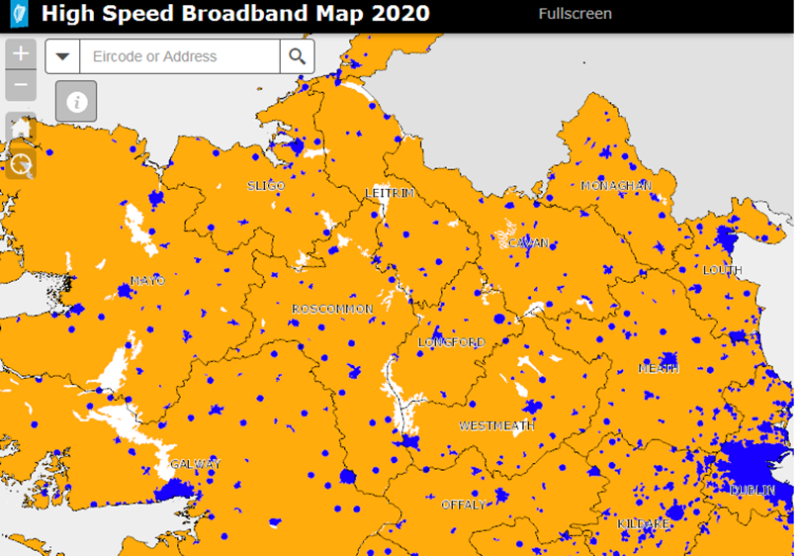
3. Where we are going – Next Steps
Government’s NBP
‘Rural’ Ireland

Slide 8
The need for speed! ….ever growing number of applications & need for broadband speed

Slide 9
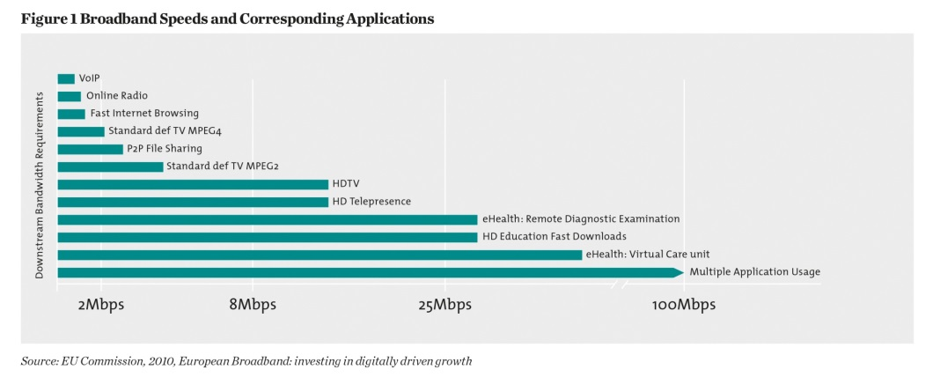
X 5 !! Multiple users, per household!

Slide 10
Broadband and Economic Growth
Broadband: No.1 priority infrastructure – NCC, CEDRA
Both a transformative infrastructure & a basic utility; similar to electrification
+10% broadband penetration: + 3.6% efficiency: + per capita GDP 0.9%-1.5%.
Contributes 6% of GDP – 75% outside ICT sector
2.6 new jobs created for every job lost through efficiency

Slide 11
Economic Benefits I
Broadband is a necessary condition for attracting firms to an area(ESRI, TCD, UL, Comreg, Jan 2016)
Increased efficiency in all Businesses
Also evidence that firms move when broadband is not available

Slide 12
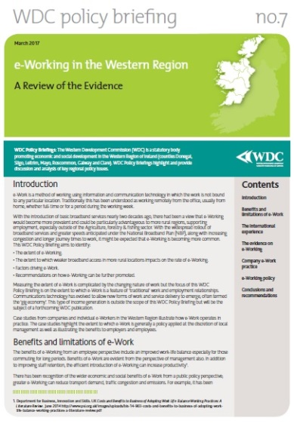
Social and Economic Benefits II
Self-emp higher in WR, rural areas also
Self –employed & jobs growth
Micro-enterprises
e-Working – access to more talent

Slide 13
Social and Economic Benefits III
e-working – a social benefit also
Better access to govt services
Communications
Education
Healthcare

Slide 14
Possible Role of Broadband officers I
For telecommunications operators
One contact – improved and more efficient communication
Officers to identify key personnel in LAs
Identify barriers to minimise delays
Identify strategic access hubs
Help standardise rules - Issues like fixed price road opening
Other?

Slide 15
Possible Role of Broadband officers II
For citizen/consumer
One contact – local knowledge & authority re Telcos
Information awareness, education & training
Rural digital strategies – need for digital training resources in LEOs/ LAs
Cooperation between Broadband officers…esp. adjoining areas
Other?

Slide 16
Thank You
Q & A
Deirdre Frost
Policy Analyst
Western Development Commission
e-mail: deirdrefrost@wdc.ie

